Slide 1


Lifelong Education & Aging Resource Network
Facing Hard Conversations: Aging, Decline, and End-of-Life Care
Billy Galligar, MD HMDC
Ancora Health Services
Jan 8, 2026

Slide 2
Learning Objectives
Identify clinical, ethical, and safety considerations in the care or older adults.
Describe important medical and legal considerations relevant to serious illness and end of life care in adults.

Slide 3
Why These Questions Matter
Most crises arise when conversations happen too late
Different professions see different pieces of the same problem
Asking the right questions earlier improves outcomes

Slide 4
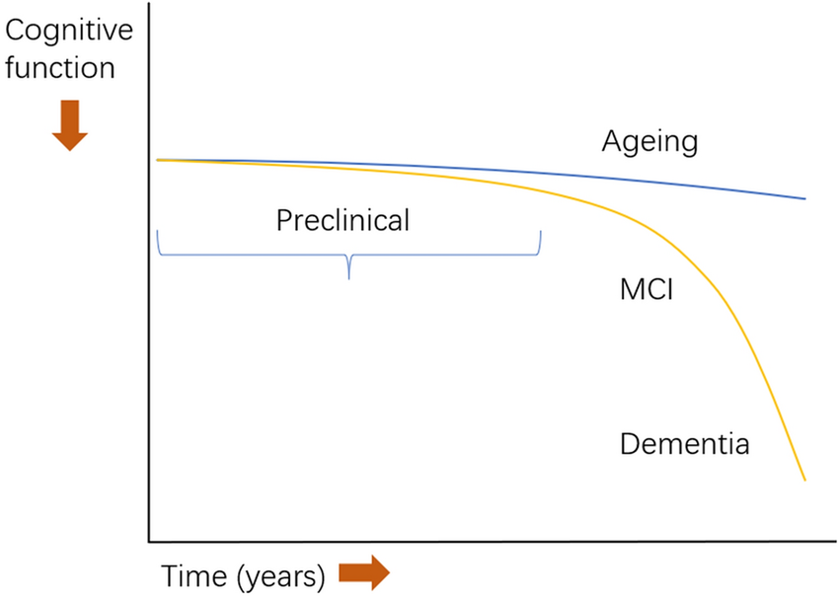
Normal Aging vs Dementia:
Neurocognitive disorder
DSM-5, 2013
Formally replaced term dementia with neurocognitive disorder
Minor, moderate, major
The reframing in attempts to be more precise, less stigmatizing, and stage-based emphasizing and continuum
Mild when cognitive decline not yet impacting independence

Slide 5
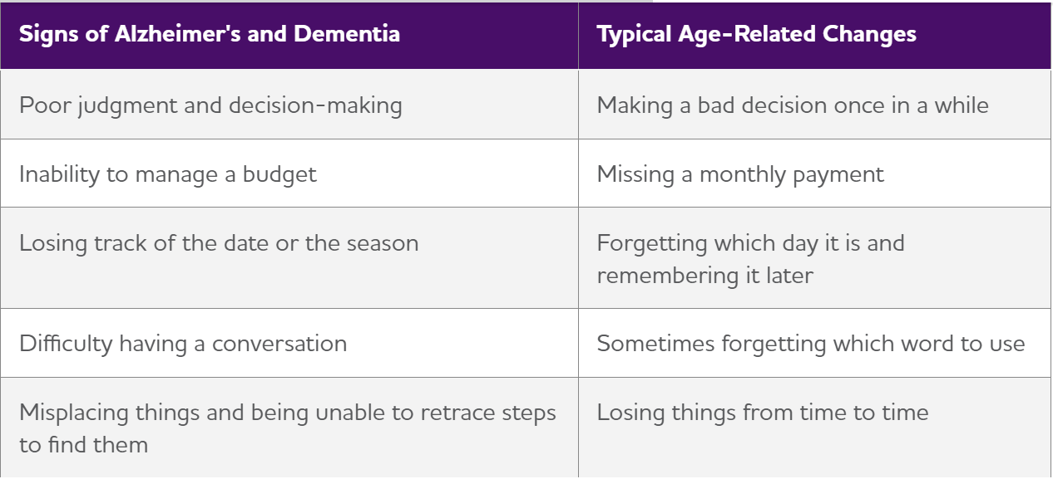
Cognitive impairment
Orange vs Red flags for neurocognitive disorder or dementia
Medical evaluation important as many conditions can mimic “dementia”
  e.g. depression/anxiety, delirium, hearing loss, medication effects, drugs, alcohol, organ dysfunction, vitamin deficiencies, electrolyte derangements, seizures, infections, brain tumors

Slide 6

When to Seek Cognitive Evaluation
Concerns warrant testing: when poor judgement impacting function and safety
What testing can and cannot determine
Using results for planning, not just diagnosis
  Primary care, neurology, geri-psychiatry, neuropsychiatric evaluations
  Labs, imaging, cognitive assessments
  Important not to ignore testing as there are some reversible conditions that can cause cognitive impairment.
Importance of caregiver education, do’s/don’ts, support groups, legal/financial planning, etc
Notes:
Testing can: guide prognostication, but no definitive tools. All in the 5-10 year range. Cannot tell you what they can or can’t do.

Slide 7
When to Step In: Care and Finances
Warning signs of declining capacity
Gradual vs urgent intervention
Preserving autonomy while reducing risk
Most important thing to do is plan and complete as many documents your loved one will allow as recommended by clinicians and estate planners

Slide 8
Documents: Must have capacity
Types of Power of Attorney
  General durable; financial; attorney-in-fact
  Health care; who, when, where
Living Will
  Road map for health care proxy, surrogate
  Only applicable while you are alive, except for funeral arrangements
  Views on life-sustaining treatments → Portable Orders
  Preferences for independence and location of care
Standard Will
  Part of estate planning, executor, beneficiaries.
  Only takes into effect after you die
Living Trust
  Avoids probate, court distribution and involvement, more tax implications

Slide 9
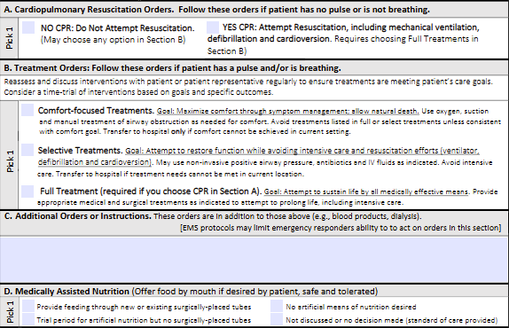

Portable Orders: POST
(Physician Orders for Scope of Treatment)
Not technically an advance directive, but an actual medical order
Travels w/ patient across settings (home, EMS, ER, SNF)
Best to use when life limited disease is present, prognosis on the order of years vs decades
Only recommended if you are limiting care
  Cardiopulmonary resuscitation, advanced airways, level of hospital care, antibiotics, blood transfusions, IV’s, feeding tubes, dialysis, etc.

Slide 10
Conservatorship vs Guardianship
  Lacking competency, court appointed, costly, time intensive
Conservatorship
Controls: the money
Bills & banking
Property & assets
Contracts & legal affairs
Benefits & income
Guardianship
Controls: the person
Medical decisions & consent
Living situation (home, ALF, SNF)
Safety & daily care
Notes:
A person may need one, both, or neither
Both require court approval & ongoing oversight
Courts favor least-restrictive alternatives first:
Healthcare POA
Financial POA
Supported decision-making
Harder to reverse than POA

Slide 11
Is It Still Safe to Live Alone?
Safety, function, and support systems
Falls, medications, meals, and isolation
Home safety assessments and care management
  Early-stage care: food/pantry, spoiled food, increased home clutter, unopened mail, bills paid, bathing/grooming, driving
  Middle and late-stage: dressing, bathing, grooming, fed, falls, unsafe living environments, caregiver burnout

Slide 12
Future Living Arrangements
Health insurance does not want to pay the mortgage or buy the groceries
Aging in place vs living with family
  Caregiver burnout
  Personal care services
    Minimal hours through Medicaid
    Contracted ~$30/hr
Assisted living: $4,000-$10,000/month
  Levels and layered costs, meals, medications
SNF (skilled nursing facility): $8,000-$12,000/month
  Rehab vs custodial care

Slide 13
When Treatment May Be Doing More Harm Than Good
Benefit vs burden framework
  No current medications make meaningful changes to risk of mortality or prevent institutionalization
  Benefits limited to delaying progression or institutionalization on the order of months not years, slight reduction in caregiver burnout, behaviors
  Risks: slow heart rates, passing out, GI upset, brain bleeds, polypharmacy
Cumulative impact of hospitalizations and procedures
Reframing goals of care conversations as things evolve
  Geriatrics, palliative care
Notes:
Anti-amyloid drugs (e.g., aducanumab-class)

Slide 14

Big Picture: Helpful
Interventions impacting outcomes:
  Treating depression
  Correcting sensory loss
  Reducing anticholinergic burden
  Exercise & mobility preservation
  Caregiver support
  Advance care planning
  Safety planning

Slide 15

Prognostication
Dementia Type | Median Survival | Key Prognostic Notes
Alzheimer’s disease | 8–10 yrs | Slower early, long tail
Vascular dementia | 5–7 yrs | Stepwise decline, ↑ CV death
Lewy body dementia | 5–7 yrs | Early hallucinations, falls
Parkinson’s disease dementia | 4–6 yrs | Post-motor onset
Frontotemporal dementia (FTD) | 6–8 yrs | Younger onset, rapid behavior change
Mixed dementia | 5–8 yrs | Very common clinically
Prion disease (CJD) | Months | Rapid, fatal
Notes:
Presentation severity impacts survival much greater than subtype:
Functional impairment at diagnosis = shorter survival
Gait disorder, dysphagia, weight loss → poor prognosis

Slide 16
Prolonging Life vs Prolonging Suffering
Aligning treatment with values and goals
When less intervention may improve quality
Shared decision-making across disciplines

Slide 17

Palliative Care: Support at Any Stage
Symptom management and decision-making support through exploring goals of care
Working alongside curative treatment
Benefits for patients and families
  Family disagreement and conflict: Keeping care centered on patient’s values in the current medical reality

Slide 18

Driving: Safety, Independence, and Risk
Driving risk is assessed medically and functionally
  Visual and medical components that cause can result in physical and/or cognitive deficits
Role of clinicians, family, and the state: we all have a responsibility for safety
  Idaho: Family Request for Re-Evaluation of Driving Privileges: Form ITD 5539. dmv.Idaho.gov
Planning alternatives before keys and cars have to be taken
  NegotiAge.com , conflict resolution/negotiation exploring interests, rights, power dynamics.
Notes:
What to do when someone refuses to stop driving?
Form ITD 5539: Type of examination requested, reason for request, relationship to driver, subject to public record disclosure
I stands for Interests. Interests answer the why question. Understanding interests uncovers the reasons why there is resistance to change.
Example: I’m trying to understand. Why don’t you want extra help?
R stands for Rights. Rights are the basis for arguments. Rights arguments are often about fairness, but they can also be about law, safety, and responsibility.
Example: I’m responsible for your care. I need to make sure you are safe.
P stands for Power. Power is the ability to make the other person do something they don’t want to do. When people make threats they are talking about power. Authority is power.

Slide 19

End-of-Life Choices
Unrealistic:
  Take me out back/forest
Reality:
  Hospitalizations
  Hospice
  Death w/ Dignity
  VSED

Slide 20
Hospice Care: When and Why
Philosophy of care vs insurance benefit
  Insurance language varies
Eligibility: prognosis <6mo
  Quality vs quantity
Wholistic multidisciplinary approach focusing on comfort and support
  RN, nursing aides, SW, chaplain, doctor, volunteers
Earlier involvement often improves experience:
  increased support, education, less complicated bereavement, improved symptom management, reducing hospitalizations, reducing CG burnout

Slide 21

Voluntary Stopping Eating and Drinking (VSED)
Intentional, voluntary decision to stop intake of food and fluids with goal of hastening death which is legal in all U.S states
  Intent to end present or imminent suffering
  Must have capacity at onset
  Patient driven w/o coercion
  Distinct from starvation from disease or neglect
  It is not:
    Suicide by conventional legal definitions
    Physician assisted death/suicide
    Euthanasia
  Ethics: Basic right of bodily autonomy, equivalent to refusing any treatment (CPR, ventilation, dialysis, artificial nutrition)
Notes:
Double effect: Foreseeable but unintended
Proportionality: treatment equal to suffering
Beneficence and non maleficence: relief of suffering

Slide 22

Death with Dignity: Medical Aid in Dying
Allows for terminally ill (<6mo) adult (>18) patient with capacity and physical abilities to voluntary self administer medication to intentionally hasten death
  Legal in multiple surrounding states: OR, WA, MT, CA, CO, NM (12 total U.S jurisdictions, ~26% of population)
  While many states have residency requirement OR and VT do not.
    Must travel to the state, reside in the state for the process, ingest in the state
    Multiple requests 2 weeks apart (verbal/written), no coercion, not driven by mental health impairments, OR has removed the requirement for multiple requests, and exceptions exist for the 15 day requirement
    Multiple clinician involvement
Notes:
Delay would cause harm and suffering

Slide 23

Death with Dignity: Medical Aid in Dying cont…
It is not:
  Suicide
  Euthanasia
Legal considerations:
  Clinicians acting in good faith are protected form civil/criminal liability
  Life insurance cannot deny benefits
  Conscientious objections are allowed, but must refer
Ethical considerations:
  Autonomy, beneficence, non-maleficence, justice
Practice | Ethical Status
Refusal of treatment | Universally accepted
Withdrawal of life support | Accepted
Palliative sedation | Accepted
VSED | Accepted (controversial but legal)
DWD / MAiD | Jurisdiction-dependent
Euthanasia (clinician administers) | Illegal in U.S.
Notes:
Ethical parallels: Terminal extubation, palliative sedation, deactivating AICD/pacemakers, withdrawal of artificial nutrition/hydration

Slide 24
Key Takeaways
These are shared challenges across professions
Early conversations reduce crisis and conflict
Collaboration is essential
Better questions lead to better planning and alignment, and outcomes for aging adults

Slide 25
Citations:
https://www.alz.org/
https://www.negotiage.com/faq
https://endoflifewa.org/end-life-choices/vsed/
https://floridadeathwithdignity.org/2025/08/10/states-where-maid-is-legal-and-whether-residency-is-a-requirement/
https://eolcoregon.org/dwd-overview/overview-of-death-with-dignity-process/
dmv.Idaho.gov

