Slide 1

Idaho Probate BAsics

Slide 2
What is Probate?
A Legal Proceeding
Appointment of a Personal Representative
The Judge Enforces the Will Instructions
Transfers Property After Death
Provides a Forum for a Will Contest
Time Consuming and Expensive

Slide 3
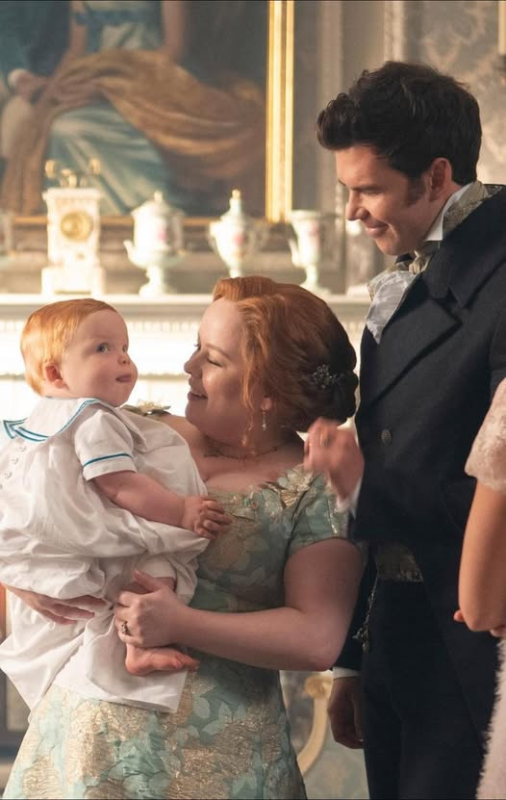
History of Probate
Conflicts relating to death, property transfer, and estates have existed since the dawn of time. It shows up multiple times in early religious books. One of the most famous ones in the Bible is probably that of the Prodigal Son.
Wills have existed since the Romans and is how we get the word Probate, it comes from the Latin probare which means “to prove”
We got probate courts in 1066 from the Normans
Colonial America continued Orphans’ Courts from English Common Law

Slide 4

History of Probate
America split from solely following English Common Law after the Revolution. This paved the way for spouses and daughters to inherit.
Current Probate Law includes influences from both English Common Law and Spanish Community Property Law. Our modern Uniform Probate Code was established in the 1960’s.

Slide 5
Who needs probate?

Slide 6
Who Needs Probate?
Probate is usually needed for assets solely in the decedent’s name without beneficiary or joint ownership designations.
Over $100,000 in assets
Or owns real property/land
If we need a court to determine heirs

Slide 7
Probate
According to Idaho Statute, the process must take at least 6 months.
There are two main types of probates, Testate and Intestate
There are two different types of proceedings, informal and formal
Judge reviews the will and appoints a personal representative
Personal Representative is given power to sign on the decedent’s behalf.

Slide 8
Probate
PR must facilitate the Estate’s payment of all valid debts
PR needs to publish a notice to creditors in the paper
PR must wait 4 months from publication for creditors to come forward
PR must make sure last tax filings are submitted to the IRS
PR is then permitted to distribute the remaining assets according to the will.

Slide 9
What if your clients don’t have a will?
No worries, the state has one for them.
Idaho Probate Code has a “One Size Fits All” will for you
Based off the nuclear family
Treats everyone equally
Can disenfranchise biological children in favor of a second spouse
Can even cut biological children out in favor of stepchildren.

Slide 10

How To Help Your Clients

Slide 11

Encourage them to do their estate planning before they become incapacitated or die.

Slide 12
Misconceptions about Estate Planning:
Writing your will does not jinx you or cause you to die.
You don’t need to be rich for a trust to be an effective planning tool.
Sometimes Estate Planning is as simple as making sure you have beneficiary designations for accounts.
Unfortunately, there is no “will reading” unless you want to orchestrate that.
I don’t judge you or your children and how much or how little you want to give them.

Slide 13

Don’t Play a Lawyer on TV…or in real life

Slide 14
Don’t Play A Lawyer on TV
Don’t download something off the internet or copy and paste from a form power of attorney. Even providing these documents as part of your business is UPL.
“The practice of law as generally understood, is the doing or performing services in a court of justice, in any matter depending therein, throughout its various stages, and in conformity with the adopted rules of procedure. But in a larger sense, it includes legal advice and counsel, and the preparation of instruments and contracts by which legal rights are secured, although such matter may or may not be pending in a court.”
(Idaho State Bar v. Meservy, 335 P.2d 62 (Idaho 1959), State v. Wees, 58 P.3d 103 (Idaho Ct. App. 2002))
(In Re Matthews, 62 P.2d 578 (Idaho 1936))

Slide 15
Don’t Play A Lawyer on TV
Avoid Unauthorized Practice of Law.
  up to a $500 fine or 6 months or both
  Idaho Code §3-420
Liability
Unintended Tax issues
Improperly drafted documents and faulty financial analysis will disqualify clients from the very programs they are trying to qualify for or unintentionally disinherit someone.

Slide 16
Legal Resources to Keep on hand
Legal Aid
  Predatory Lending, Housing, Powers of Attorney and Advanced Directives, Guardianship and Conservatorship of an Adult
Faces of Hope
  can help with DV and Elder Abuse
Nampa Family Justice Center
  DV and Elder Abuse
Idaho Volunteer Lawyers Program and the Idaho State Bar Association
  Low/No Cost Legal Assistance

Slide 17
Questions??

