Slide 1


Community Emergency Preparedness
LEARN: Lifelong Education and Aging Resource Network
February 12, 2026
Lauren Soares
Public Health Preparedness, Planner
Central District Health

Slide 2
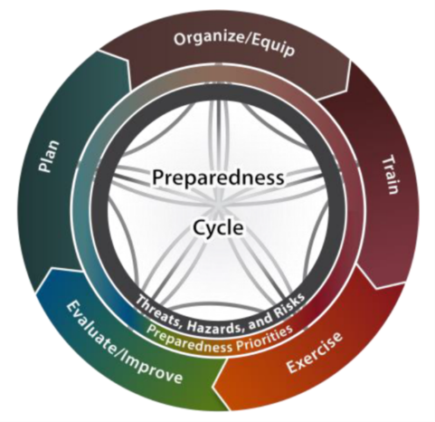
How to engage with Local Emergency Preparedness and Public Health
Attend LEPC Meetings
  Local Emergency Planning Committee Meeting
Volunteer with MRC
  Medical Reserve Corps
Ask Public Health Preparedness to come talk to your community and groups

Slide 3
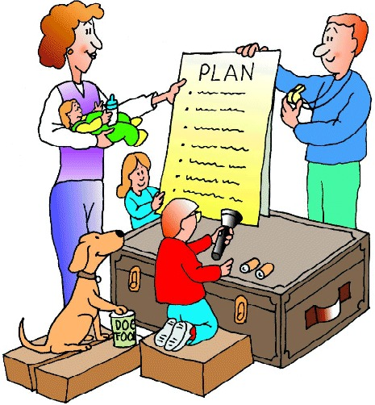
Preparedness Topics
Home Plan for Family
72 Hour Kit
  What, How, Why, Where
Personal Go Bag

Slide 4

Home Plan for your Family
What do you need to plan for?
In Idaho, it will most likely not be a forecasted disaster or emergency
Who do you need to plan for?
Who are you responsible for?
Don’t forget about pets & livestock.

Slide 5
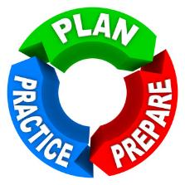
EVERYONE at home needs to know the family plan
If you are not at home who will . . .
  Keep order and/or provide emotional support for minors
  Ensure safety
  Shut off utilities
How will you communicate
  Do you have an out of town point of contact?
  Text messages will be the last piece of wireless communication to fail
Where are family members instructed to go?
  If not X, then Y location – this takes some trust and faith

Slide 6
During a disaster or an emergency
Needs vs. Wants will be easy to distinguish
Basic Needs Include:
Safety
Shelter
Water
Food

Slide 7
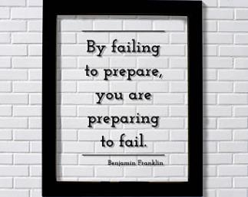
72 Hour Kit
Plan enough emergency supplies to keep you and your family alive and comfortable.
It may be hours or days before responders can reach victims or stabilize infrastructure so victims can leave.
72 Hours = 3 Days

Slide 8


Safety
Shelter
Home Plan for Family
  Kids?
  Elderly?
  Special needs / special diet / medication?
Know where utility shut offs are
  Gas
  Electric
  Water
72 Hour Kit
  Include a first aid kit
  Crank radio / flashlight combo

Slide 9

Water Storage
Water
1 Gallon of Water per person per day
(Include pets)
Bottled Storage
Hot Water Heater
Ice
Water
Humans can survive up to 3 days without Water
Bath Tub
Pre-Storm Storage
Purification Methods

Slide 10
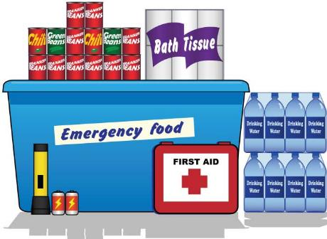
Food Storage
Food
Foods with long shelf life
  Canned foods
  Dried foods
  Pre-packaged individual servings
Conserve Water by using
  Disposable plates & plastic silverware
  Baby wipes for personal hygiene
Humans can Survive up to 3 Weeks without Food

Slide 11
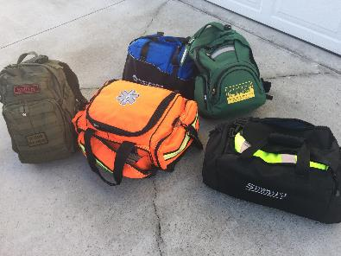
Go Bag(s)
A Go Bag is like a home 72-hour kit but is a portable bag for 1 person’s supplies.
Plan enough emergency supplies to keep you comfortable when away from home.
It may be hours or days before you are able to return home. Each person in your house should have a Go Bag.

Slide 12
Go Bag Contents
Ideas for your bag:
Clothing
  3 days, season appropriate
  Socks & underwear
  Light jacket
Water, Food, Snacks
Hygiene items – toothbrush, comb, deodorant
Crank radio/flashlight/cell phone charger
Tape, zip-ties
Pen, sharpie marker, paper
Photocopies of important documents or licenses
Deck of cards, book

Slide 13
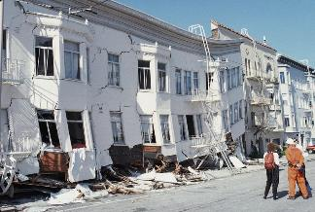
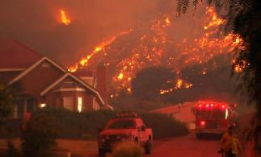
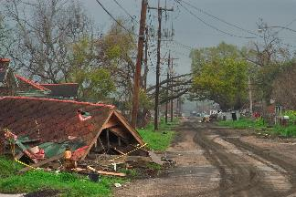
Exercise
Listen, Think, Reflect
Handouts – Preparedness Plan Handout
  Ready.gov – Emergency Communication Plan
  Your Disaster Checklist
  Prepare Your Pets for Disasters
  MRC – Everyday Hero
Homework:
Make a Plan
Pack a Kit for Home and Bag for GO

Slide 14

Thank You!
Questions ? ? ?
Lauren Soares
Planner
Central District Health
Lsoares@cdh.Idaho.gov
208-514-5569 (cell)

