Slide 1
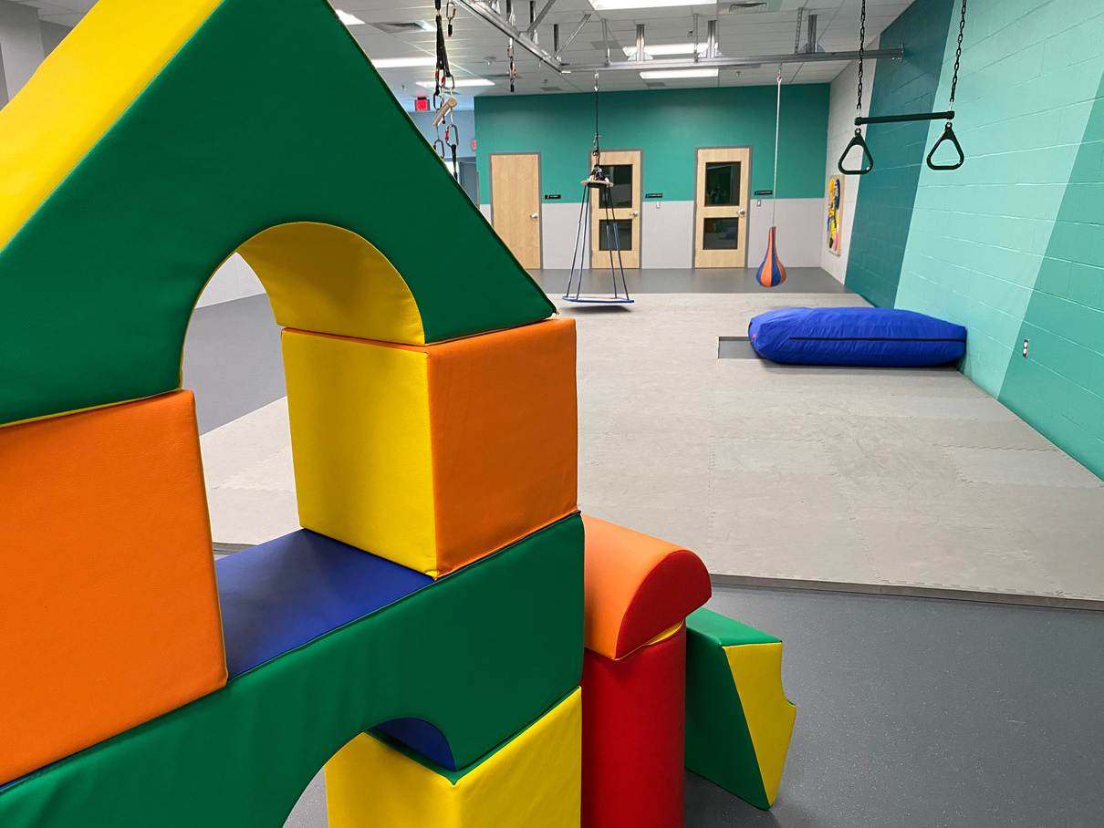


EVERYDAY VICTORIES
THRIVE
THRIVE FUNDRAISING EVENT & LUNCHEON
Notes:
1

Slide 2
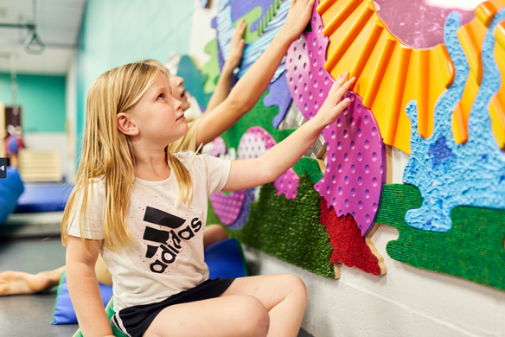
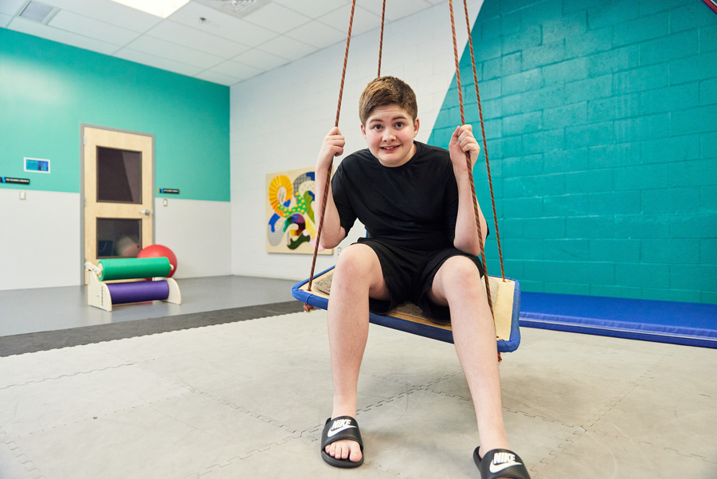
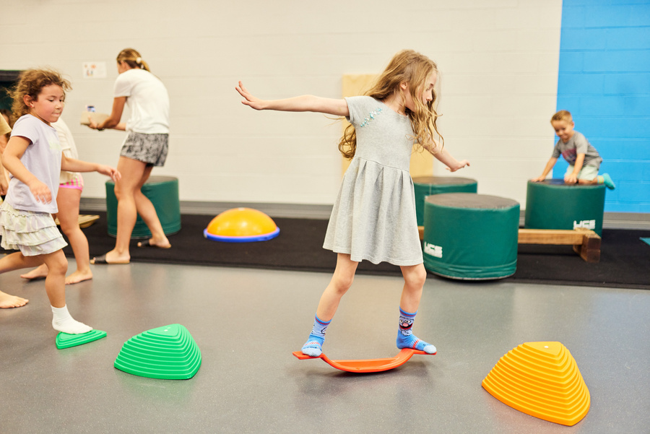
QUICK FACTS
THRIVE
  The Blue Cross of Idaho THRIVE Center helps fill the gap in services and was started because of community members like YOU!
  All spaces and programs receive input from Advisory Committee before implementation.
  1 in 31 kids are recognized with Autism Spectrum Disorder (ASD).
  10% of children in West Ada School District utilize an Individualized Education Plan.
Notes:
2

Slide 3
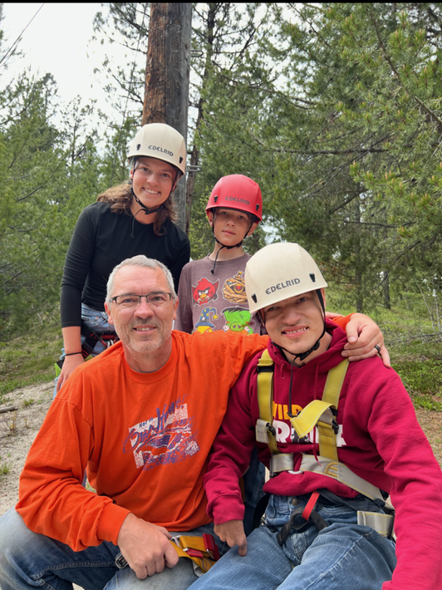
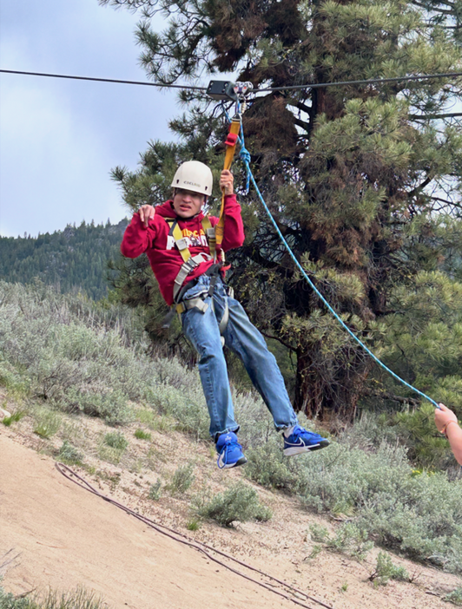
THRIVE
Y CAMP AT HORSETHIEF
THRIVE FAMILY CAMP 2025

Slide 4
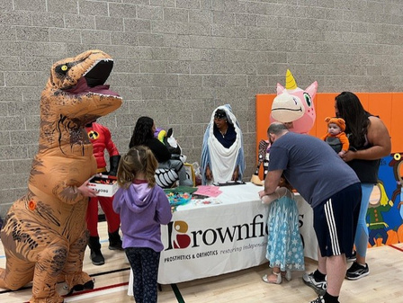
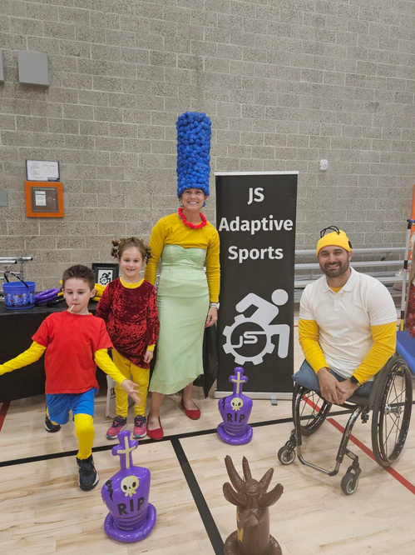
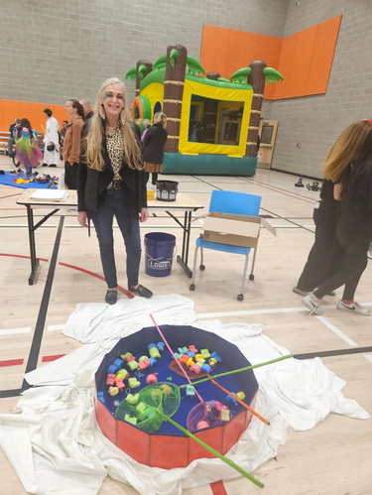
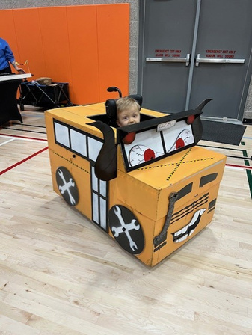
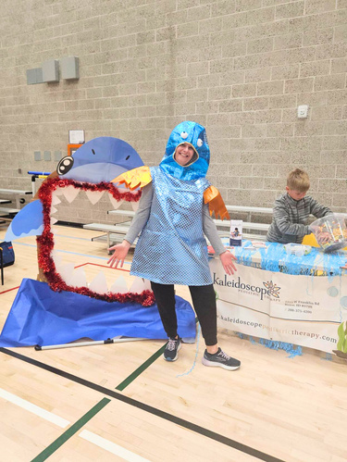
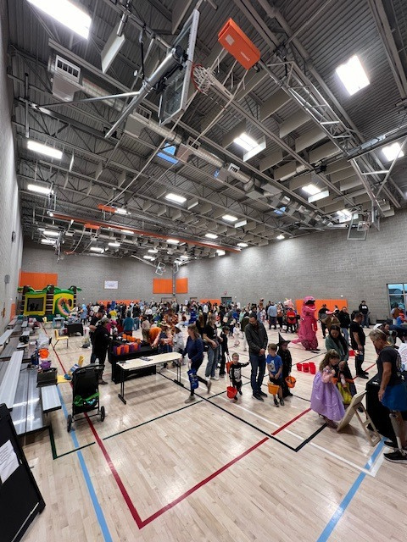

THRIVE
HALLOWEEN CARNIVAL

Slide 5
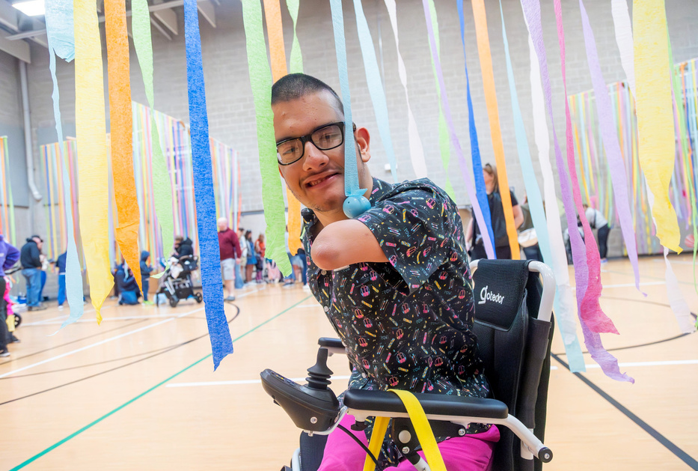
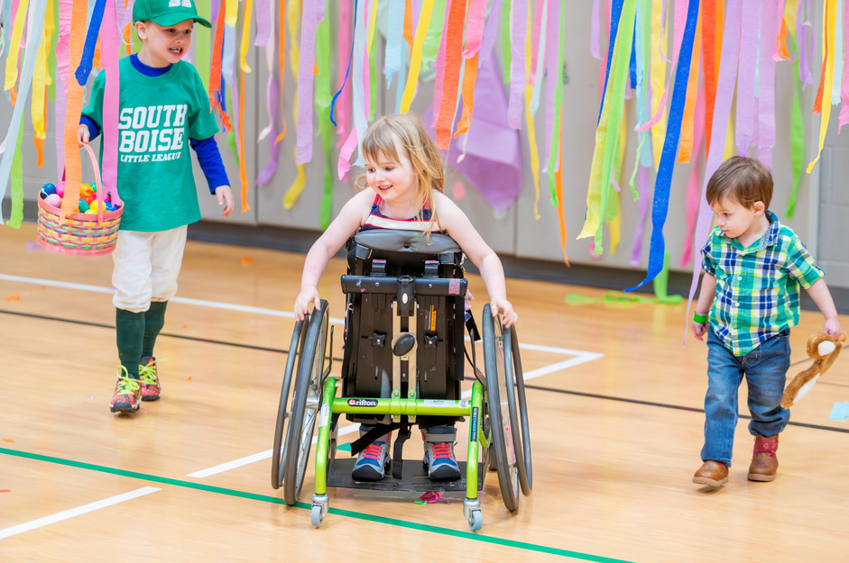
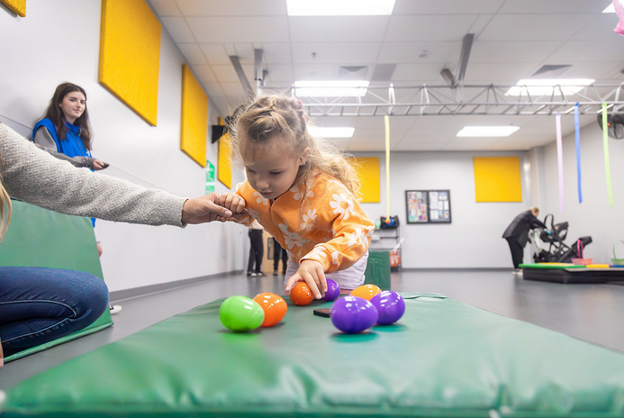
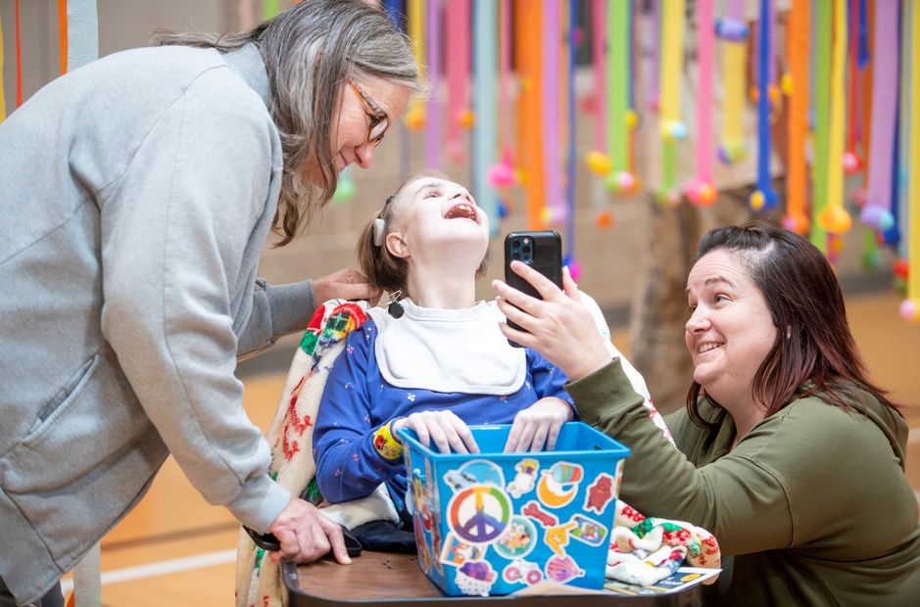
ADAPTIVE EGG HUNT
THRIVE

Slide 6
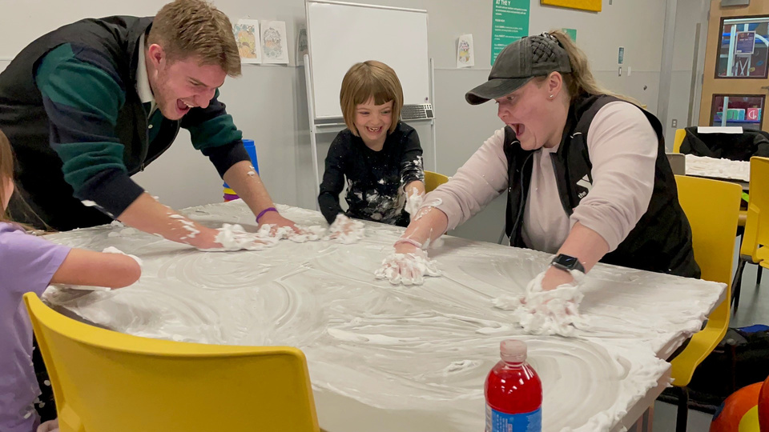
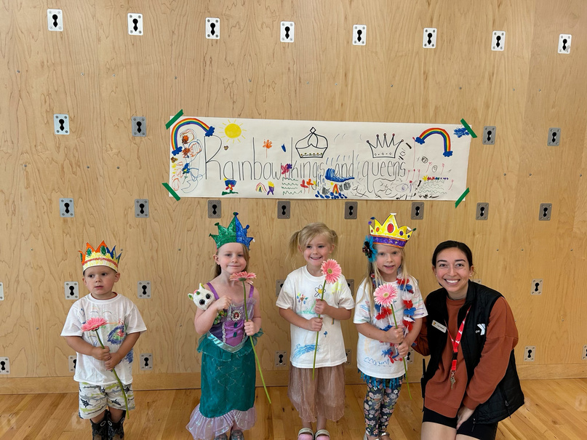
THRIVE 2025 CAMPS AND PROGRAMMING
THRIVE
  Summer Camps: 289 (109 more than 2024) Participants + 30 participants for Rays for Rare specialty camp
  THRIVE Programs: 275 Participants
Notes:
5

Slide 7
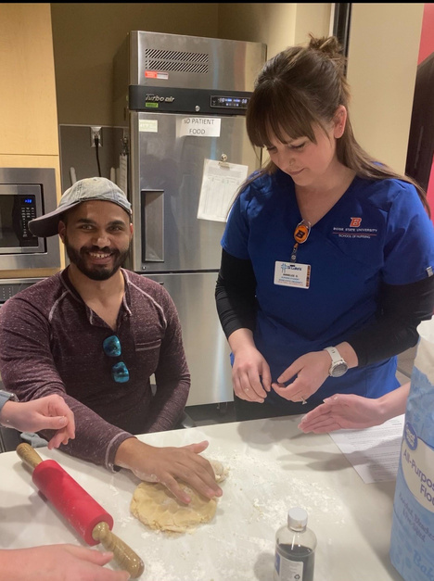
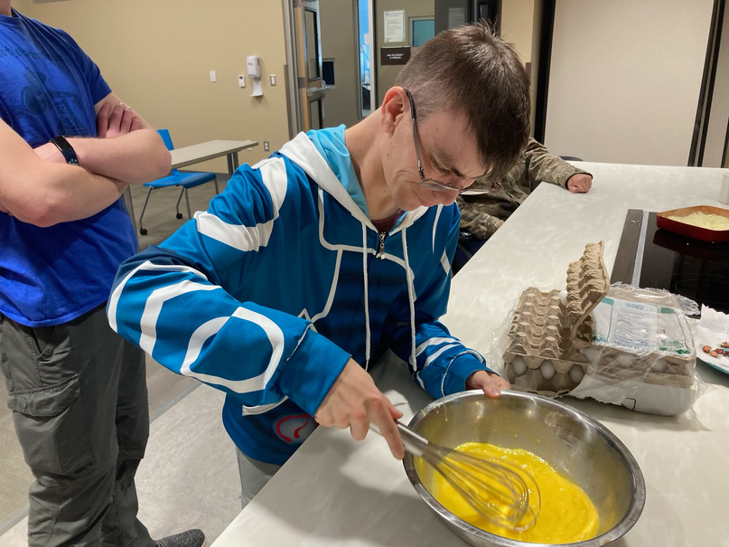
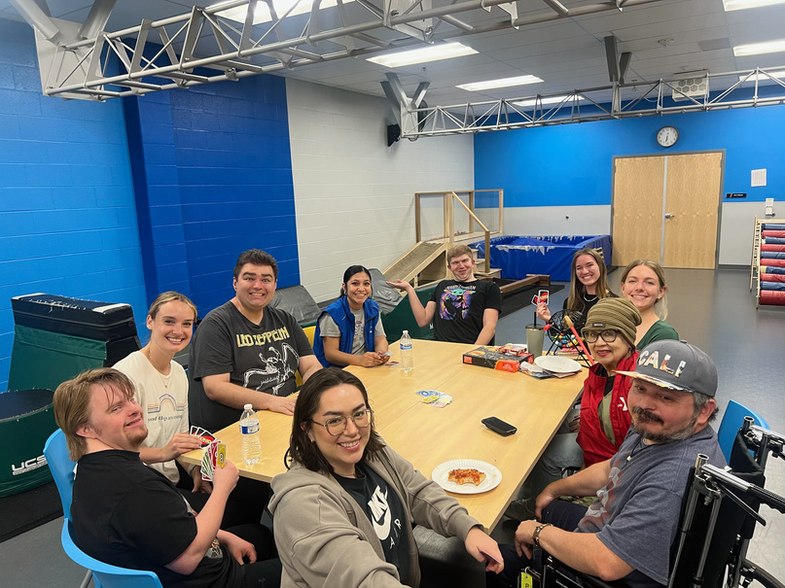
ADULT PROGAMMING
THRIVE
6

Slide 8
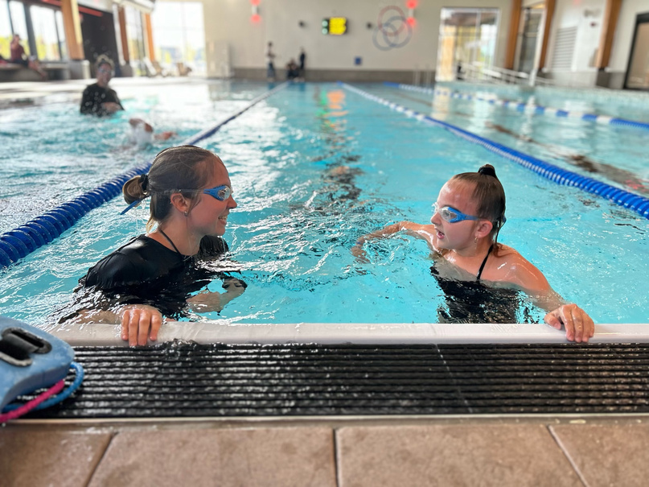
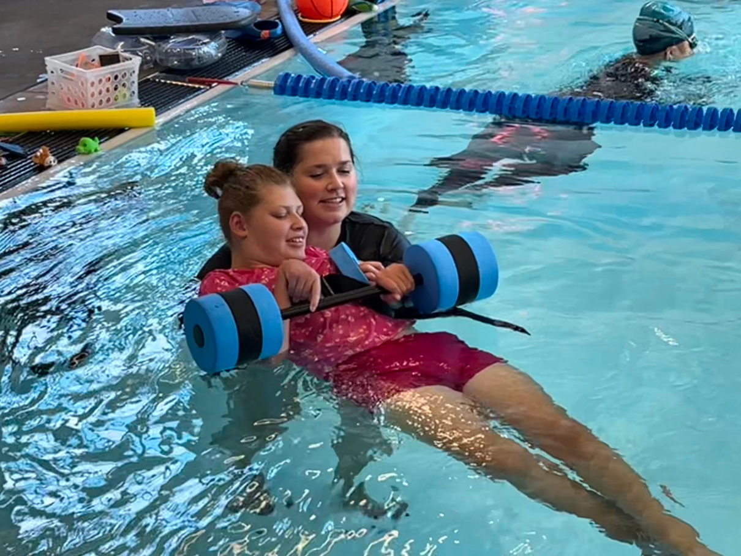
AQUABILITY
THRIVE
Children with ASD are 160 times more likely
to drown than neurotypical children.
413 participants served in AquAbility in 2025!

Slide 9
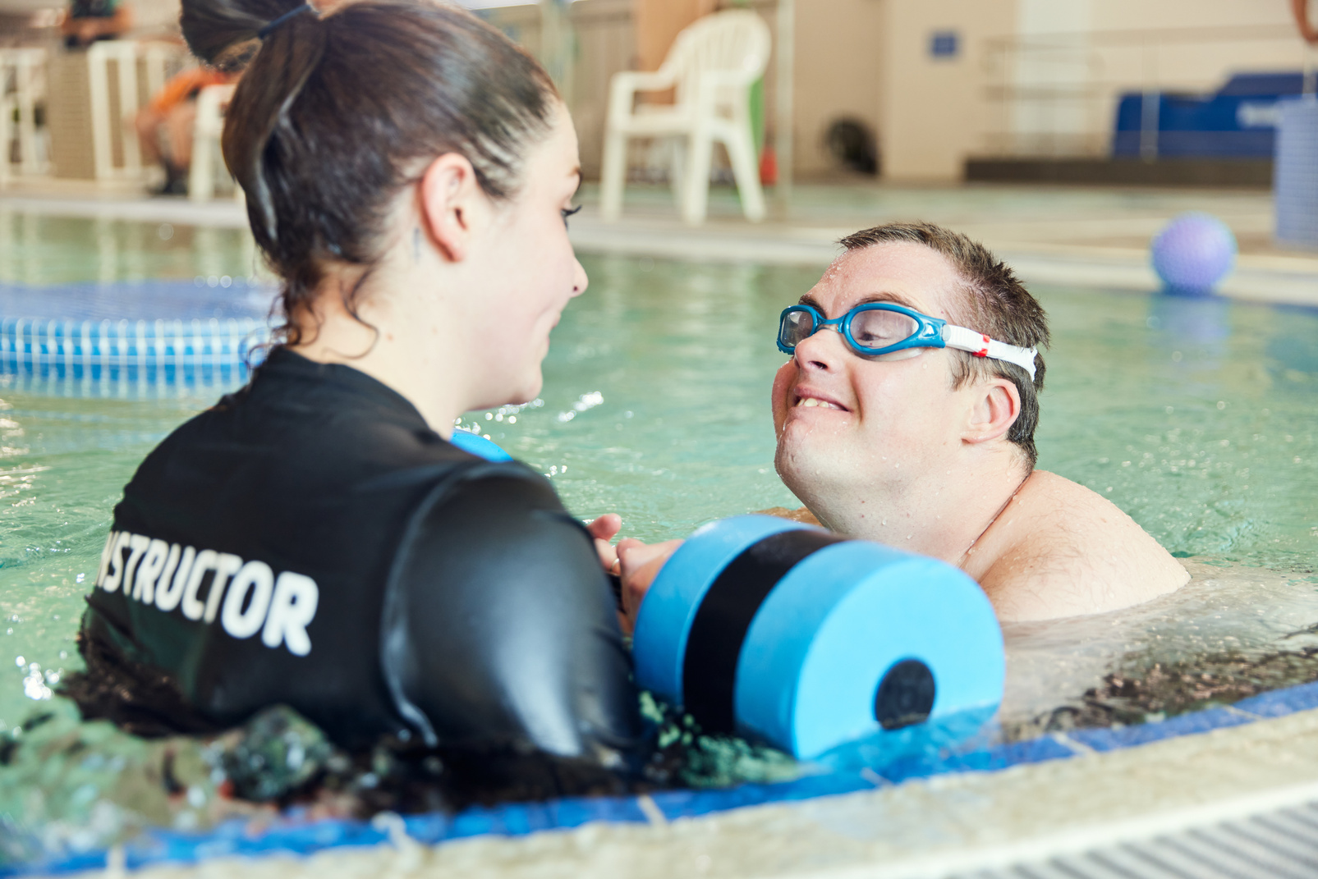
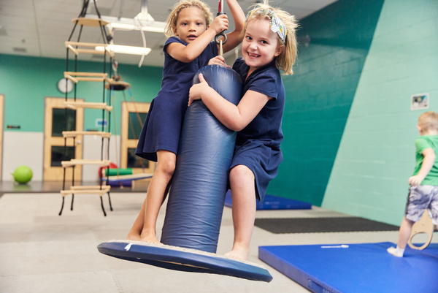
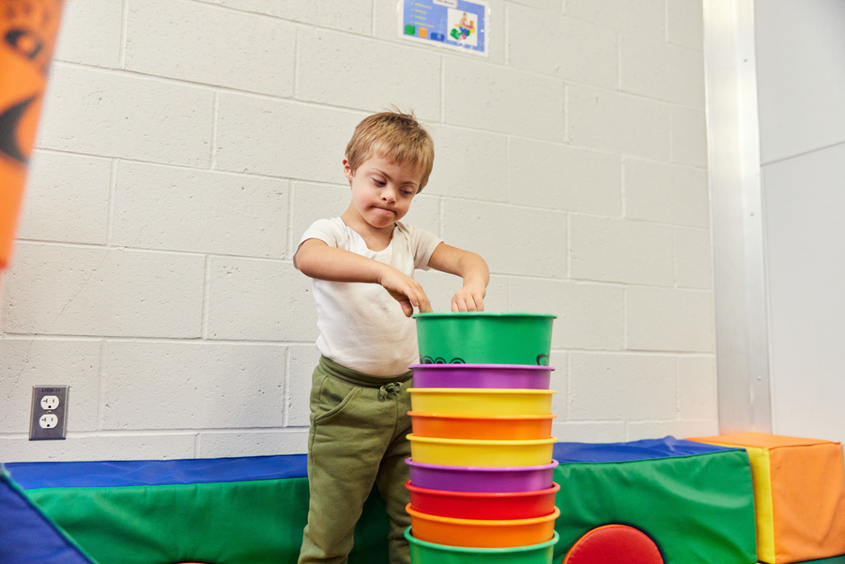
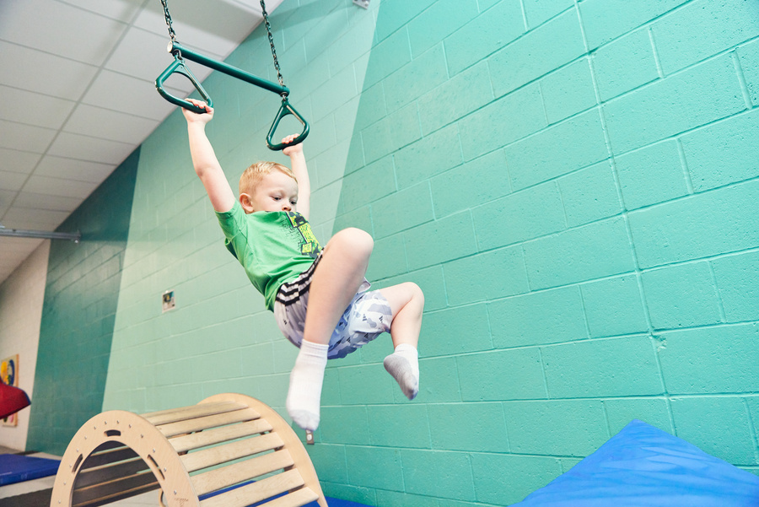
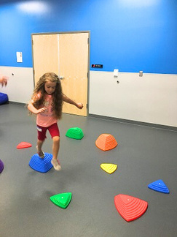
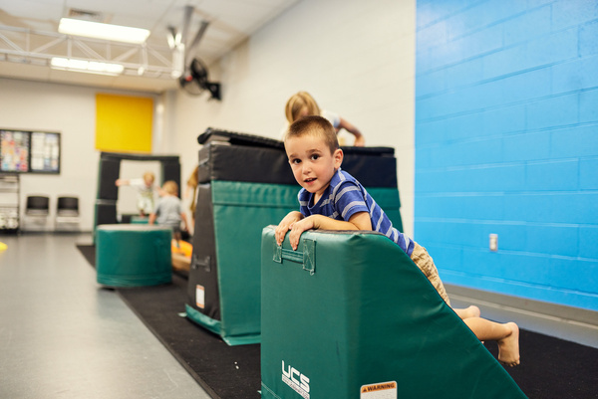
THRIVE
THANK
You

